Slide 1
SNNs for Fast-Moving Object Detection

Slide 2
Ball Throws
Simulated
Plan A: With Isaac Sim (Maybe not worth it)
Plan B: Just with Python
Real
To check the output of the event camera

Slide 3
Video to events
V2E -> Colab
VID2E
V2CE
ESIM
Plenty of options. Whichever that looks like the real event camera output.

Slide 4
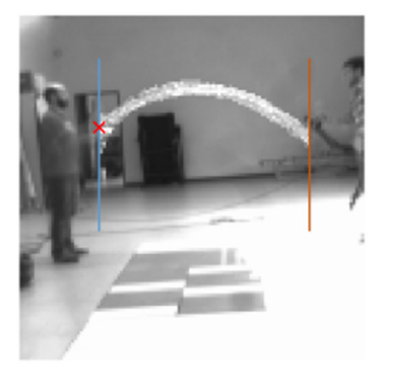
Literature review
Event-Based Trajectory Prediction Using SNNs
Event camera with spatial filtering
SCNN with STDP (unsupervised)
They predict the height of the ball and the x for two possible x values (left or right) in a 2d parabola
RMSE
We don’t need unsupervised training (as long as the simulator is good enough). Maybe better results.
Preprocessing the data will increase the inference time
We would predict the impact point on a fixed plane.

Slide 5
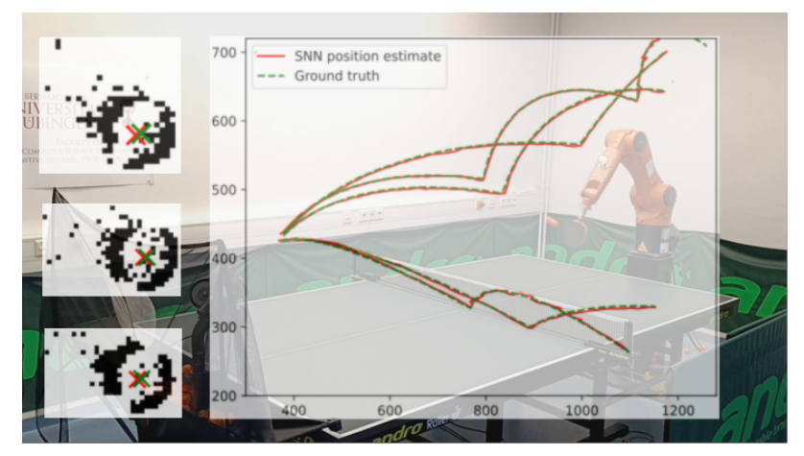
Literature review
Detection of Fast-Moving Objects with Neuromorphic Hardware
SCNN
With ROI defined on the last known ball position.
Diff. Architectures and training method depending on the spiking chip used.
Classification problem to find the pixel for the ball position (2d)

Slide 6
Literature review
SCTN: Event-based object tracking with energy-efficient deep convolutional spiking neural networks
3 layer SCNN + 3 FCL
Learning algorithm STCA (supervised)
They sample 256 possible boxes around the expected target positions and they check the one with more spikes. Seems like a very suboptimal and slow approach.

Slide 7
Literature review
Robotic goalie with 3 ms reaction time at 4% CPU load using event-based dynamic vision sensor
Cluster tracker algorithm (no SNN)
Goalie calibration
Explanation of USB interfaces for sensors and actuators (maybe relevant in the future)

Slide 8
Literature review
Event-based Agile Object Catching with a Quadrupedal Robot
Two phases: trajectory estimation + robot actuation
Trajectory estimation
Moving object detection DBSCAN clustering algorithm
Remove outliers with RANSAC then fit to a parabola
Find intersection with the plane
No SNN

Slide 9
Literature review
Event-Based Angular Velocity Regression with Spiking Networks
Regression problem (continuous values of angular velocity)
Global Average Spiking Pooling to avoid last FCL
Less parameters
Improved robustness to spatial translation
Results could be better, but they didn’t learn the hyperparameters (potential improvement)
Code available uzh-rpg/snn_angular_velocity: Event-Based Angular Velocity Regression with Spiking Networks

Slide 10
Literature review
TossingBot: Learning to Throw Arbitrary Objects with Residual Physics
Residual physics: DL to learn a residual on top of the physics result
Apart from that the problem is very different. No object tracking nor trajectory estimation.

Slide 11
Approach
Events -> Trajectory (regression problem. Complex and slow)
Events -> Impact point (assuming no additional movement of the robot)
Classification task
Problems: many trajectories don’t have impact point.
Solutions:
Training two models, one for checking if there is an impact point and one for finding it.
Selecting carefully the training data.

Slide 12
Plan A: Classification
ROI / Spatial filtering?
SCNN w/ surrogate gradient (easy to implement, supervised)
GASP
Classification on X and Y in the goal

Slide 13
Plan B: Regression
ROI / Spatial filtering?
SCNN w/ surrogate gradient
GASP
Position and velocity of the ball
I would say this is too difficult

Slide 14
SNN Architecture
Options
RSNN
LSM
Few hyperparameters
Fast inference and fast training
SLSTM
More hyperparameters
Best results
Slow training
SGRU
Fast inference and fast training

Slide 15
SNN Architecture
Non recurrent
SCNN + LIF
SCNN + Transformer
Hybrid
SCNN + RSNN

Slide 16
Approach
SCNN + LIF (Should be enough as the velocity is encoded in each frame)
If it is not accurate enough -> SCNN + SGRU / SCNN + LSM
If it is still not accurate enough -> SCNN + SLSTM
- inference time +

Slide 17
Plan C: RNN
SCNN + LSM
Is a good way of adding temporal processing (in case the SCNN fails on that)
Limited literature on the topic.

Slide 19
All that use SNNs do it in 2d. Maybe add another camera and do it in 2d?
Binary classification goal/not goal. Then find the impact point.
Take into account robot position.
ROI with changing size. This is possible because neurons with no input have no spikes thus no computation is done.

Slide 20
